Slide 1
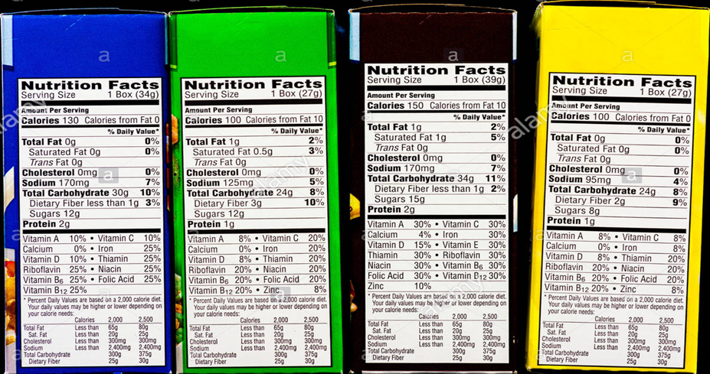
Cereal Success
Nick Ruocco

Slide 2
Background
Cereal, it’s the breakfast choice of millions of people.
But with so many brands and choices, the question arises, why do people choose a certain cereal over others? What factor attracts people the most? That is what I am trying to discover.
I will be using the dataset Cereals_2, which is a modified version of a modified version of the Cereals dataset retrieved from https://github.com/reisanar/datasets.git. To try ascertain what variable has the biggest influence on a cereals overall rating.
I will also be utilizing the tidyverse library package.

Slide 3
Ingredients
The dataset contains 76 observations, each in the form of a different cereal, and 9 variables.
1. Name: Name of cereal
2. mfr: Manufacturer of cereal where G = General Mills; K = Kelloggs; N = Nabisco; P = Post; Q = Quaker Oats; R = Ralston Purina
3. calories: calories per serving
4. protein: grams of protein
5. fiber: grams of dietary fiber
6. carbo: grams of complex carbohydrates
7. sugars: grams of sugars
8. shelf: display shelf (1, 2, or 3, counting from the floor)
9. rating: the rating of the cereals from consumer reports.\

Slide 4

Nutrition Facts
Nutrition Facts & Graph Facts
I started the analysis by creating a few baseline variables that we can compare all the entries and companies to no matter their different scales. I calculated the averages for ratings, proteins, sugars, carbos, fiber, calories, and shelf placement. All of these are measured in grams.
avg_rating = 42.5
avg_sugars = 7.1
avg_carbo = 14.8
avg_fiber = 2.2
avg_protein = 2.5
avg_calories = 107
avg_shelf = 2.21
The graphs I will utilize contain the individual entries of each manufacturer’s cereals to create a general trend line based on the behavior of the points.
I chose to use this as it created a smoother and easier to understand visual on the graph to display the patterns for each manufacturer cereal rating.
I also left the individual observation points in the graph as well. This was to also display the patterns these points followed alongside the smoothed and simplified trend line

Slide 5
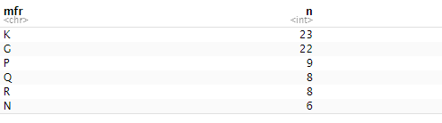
Observation groups
We will be analyzing variables 3 through 8 to determine which has the biggest influence on variable 9, the overall rating.
We will also be grouping the entries by their manufacturers as the classifiers for the cereals, instead of graphing and analyzing each cereal individually
Keep in mind that some manufacturers will have greater influence over the data set observations than others, due to having more entries in the dataset.
Kellogg's
General Mills
Post
Quaker Oats
Ralston Purina
Nabisco

Slide 6
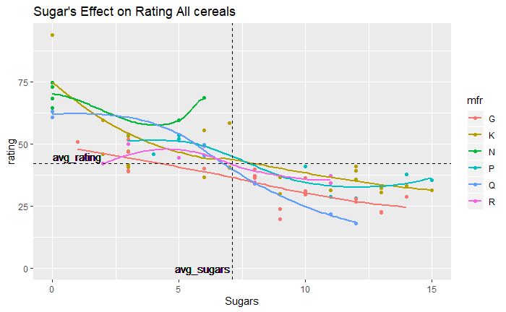
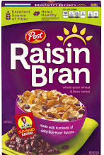
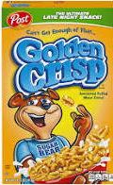
Sugars
So our first observation is the effect of sugar on ratings. We can already see a negative trend.
We can see the individual dots representing the actual entries from the data set. But we have them sorted by manufacturer.
The focus though is on the trend line created based on the individual manufacturers.
And as we can see for the large portion of these manufacturers, their ratings drop drastically in relation to increased sugar.

Slide 7
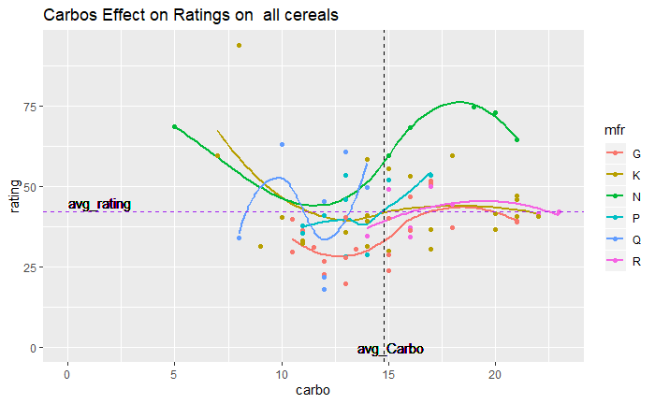
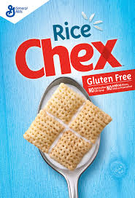
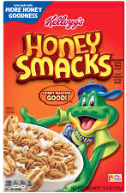
Carbohydrates
Carbos or carbohydrates have a surprising trend to observe.
Carbohydrates are generally associated with unhealthy foods.
But we can observe a trend Most of the lines are following a drop and rise pattern.
It seems many companies patterns have their cereal ratings increase as their carbohydrates do, and all in a similar fashion.
Even if the changes aren’t as drastic amongst all the brands, carbs may actually benefit a cereal rating after reaching a certain point. Even the lowest rated brands, in this case General Mills(red) ends with better ratings in their pattern line than they started. Just on the cusp of surpassing the average.

Slide 8
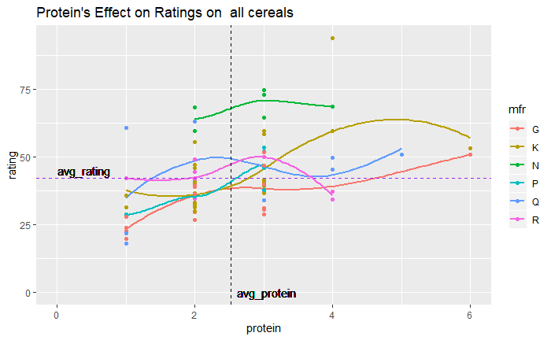
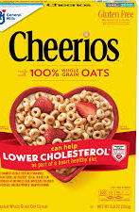
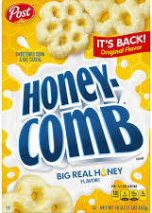
Protein
Protein is generally considered to be a healthy component to food and thus a cereal with higher than average protein could benefit from that.
This seems to be the case. Every manufacturer’s pattern line gradually increases along with its increases in protein.
Nabisco(green) already starts with higher rating as they have extremely high fiber cereals.
And the majority of other manufacturers with increasing protein. end with far higher ratings than where their pattern started .

Slide 9
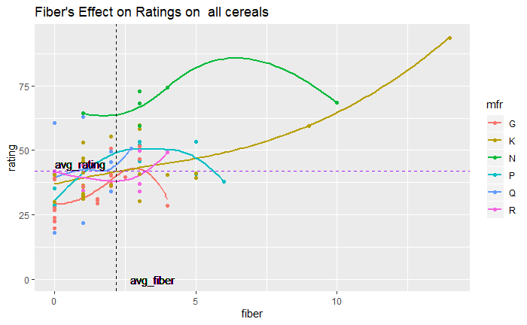
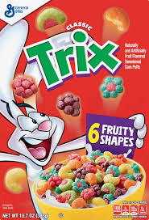
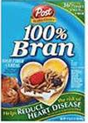
Fiber
Fiber is also considered to be a positive healthy factor, especially found in cereals.
So how much does a high fiber diet benefit these cereals and their makers?
Kellogg's line is a bit skewed here as it does have two highly rated cereals that are also high fiber. Those being All Bran With Extra Fiber. As well as the case with Nabisco, having several high fiber cereals.
It would appear that Fiber does overwhelmingly contribute to a cereal’s success.
However we should remember that the higher number of Kellogg's cereals gives a wider range of ratings and patterns.
There are only 2 cereals that have more than 10 grams of fiber. While we have seen plenty of more successful cereals on other charts the majority being lower fiber.
Thus I don’t believe fiber is as key to success as this graph implies when all the companies are on one graph.

Slide 10
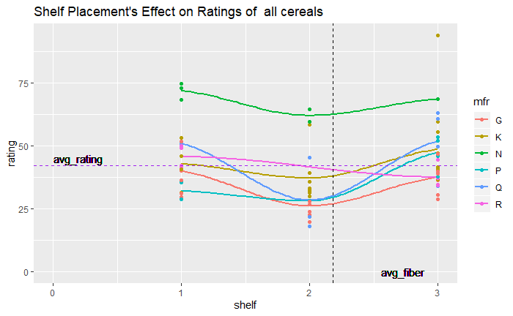
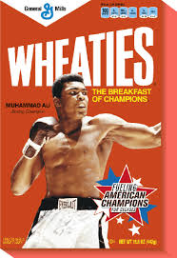
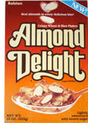
Shelf placement
Admittedly this one is a bit strange to observe as there are only 3 possible values, shelf 1, 2 or 3 (from bottom to top).
But, upon observation there is another pattern that can be seen.
It is clear that ratings tend to be higher for cereals on the 3rd shelf and 1st shelf. But the appears to be a dip in popularity for cereals on the second shelf.
The pattern is present most clearly in General Mills(red), Nabisco(green), Kellogg's(yellow), and Quaker Oats(dark blue) and post(blue) .
Ralston Purina (pink) does break the trend but it also only has 8 entries and could be considered an outlier.
Especially since Nabisco has only 6 entries and follows this pattern as well.
So shelf placement could be more influential than I thought.

Slide 11
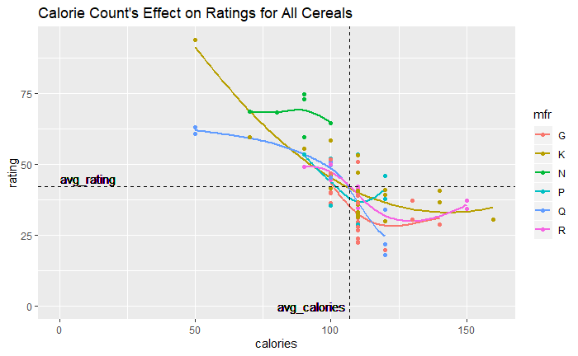
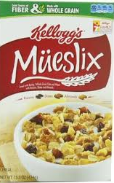
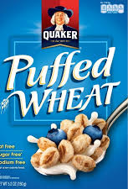
Calories
Once again we see a negative trend for the manufacturers. The pattern lines drop drastically even before reaching the average calorie checkpoint line.
This does make sense as calories are the culmination of every other health factor and is usually the first thing a person observes when buying food.
And anything over 100 calories is generally seen as unhealthy, and thus undesirable and lower rated.

Slide 12
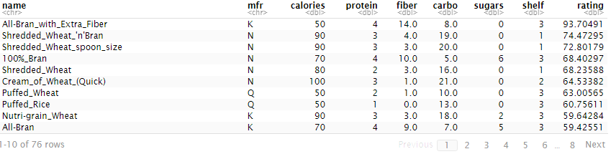
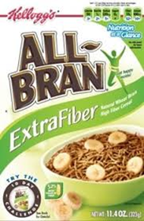
Conclusion
We can observe this by simply looking at the rankings of the cereals. These cereals are arranged by rating and the most consistently changing variable is the calorie count. Every other variable jumps around in values, and while there is some evidence of their influence. Calories are the most consistently changing and increasing as the overall rating for each cereal decreases. This was a pattern also shown in its’ graphing last slide.

Slide 13
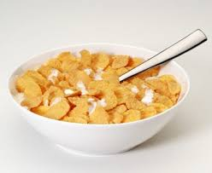
Conclusion
Out of all of these variables I conclude that calorie count has the greatest influence on a cereal’s rating.
It is one of the first things advertised on any box, and is the cumulative measurement of all of the other ingredients and how they effect one another
Calories take into account sugar, carbs, and protein. All individually have a strong effect on ratings. But when used together in the form of calories, the result is calories having a stronger influence than any other factor. The higher amount of calories, the lower the rating.
From all of these simple observations I believe my conclusion that calorie count is the most greatest influencer of a cereal’s rating, is supported.

